Slide 1
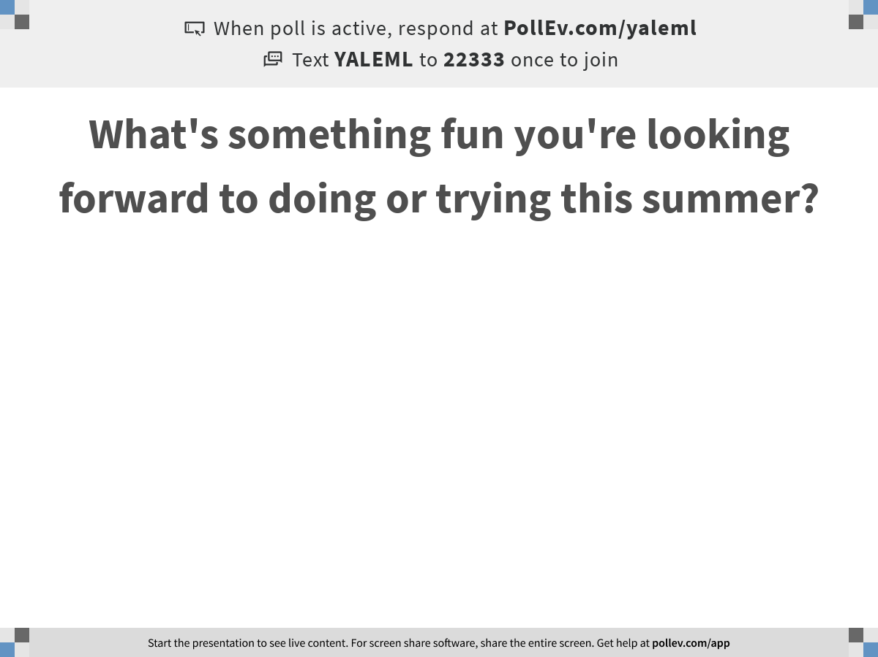
Notes:
What's something fun you're looking forward to doing or trying this summer?
https://www.polleverywhere.com/free_text_polls/OO0KsZ91Xb5UrcMTPQWnw

Slide 2
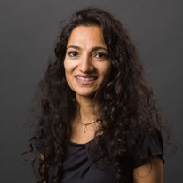
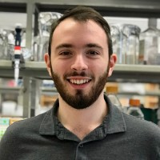
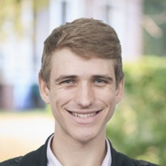
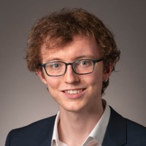
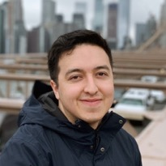
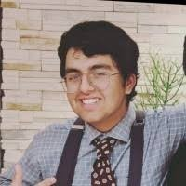
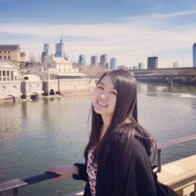
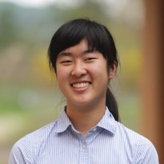
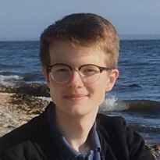

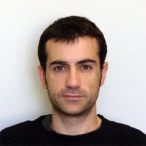
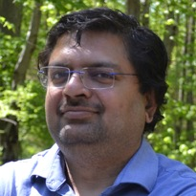
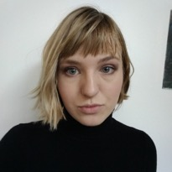
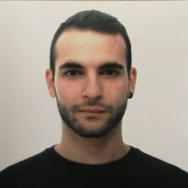
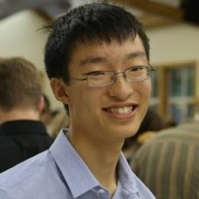
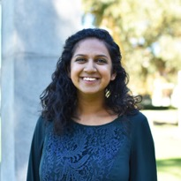
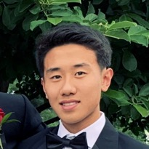
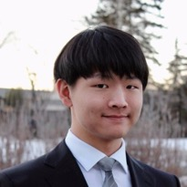
Smita Krishnaswamy
Daniel Burkhardt
Scott Gigante
Andrew Benz
Egbert Castro
Pranik Chainani
Joanna Chen
Annie Gao
Michał Gerasimiuk
Wes Lewis
Francesc Lopez
Sameet Mehta
Sasha Safonova
Giacomo Scanavini
Alexander Tong
Aarthi Venkat
Max Yuan
Jeffrey Zhou
Giacomo Scanavini

Slide 3
How to train your network
Training the network
Running the network
Randomly initialize all weights and biases
Run the network on a set of training data (batch)
Compare the output of the network to the expected output for the input using the cost function
Calculate the gradient of the cost function
Update the weights and biases according to the gradient using backpropagation
Repeat steps 2-5 until convergence
Compare results to the validation set to evaluate the performance of the network
If performance on validation set is poor due to underfitting or overfitting, reconfigure the network hyperparameters (e.g. # nodes, # layers, activation function, etc) and repeat 1 - 8
Run the network on your data
If your data is sufficiently different from the training data, you will need to retrain the network

Slide 4

http://bit.ly/YaleML_Jan2021

Slide 5
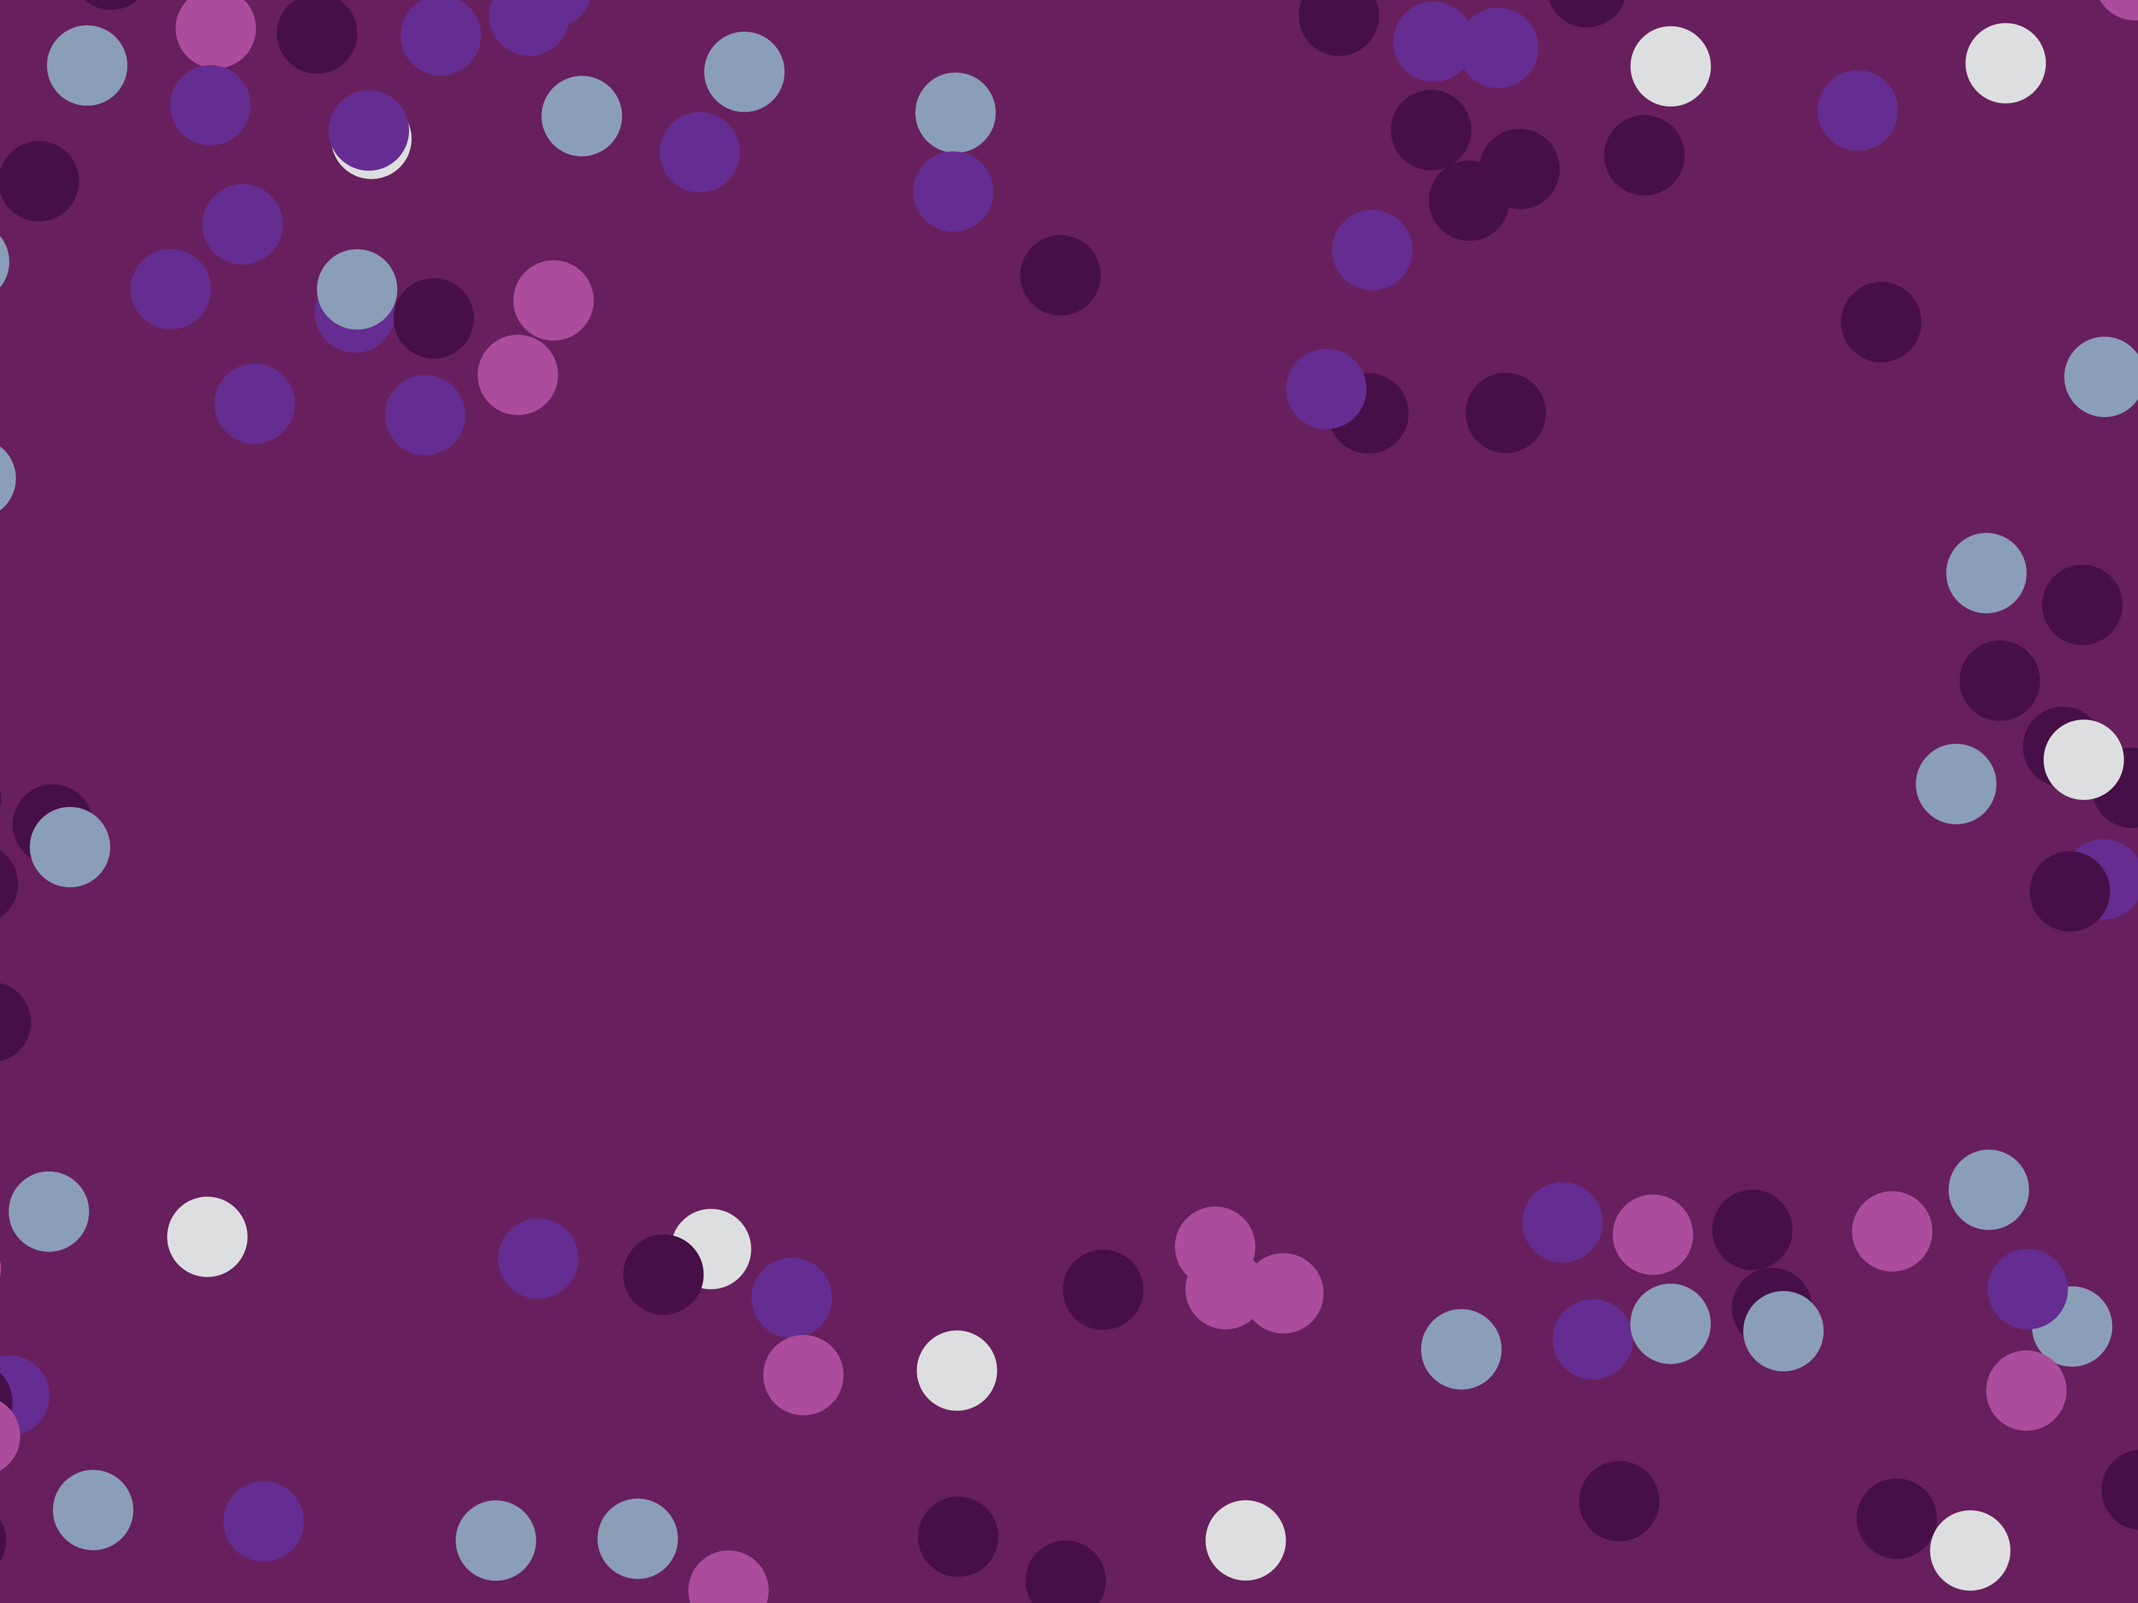
Autoencoders, GANs, Conditional GANs, Cycle GANs in Single Cell Analysis
Notes:
TA introduction
Talk about not teaching code (not a programming workshop)

Slide 6
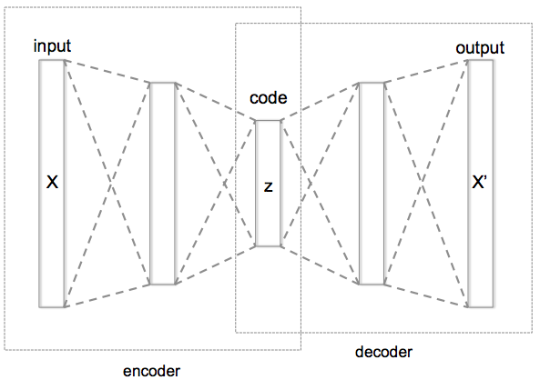
Autoencoder
Informational Bottleneck
[Hinton, Salakhutdinov, Science 2006]
Notes:
Here is an example of an autoencoder. The autoencoder tries to reconstruct its input, after passing it through the layers of the network.
Notice that there is an informational bottleneck here that we’ll talk about in a second.

Slide 7
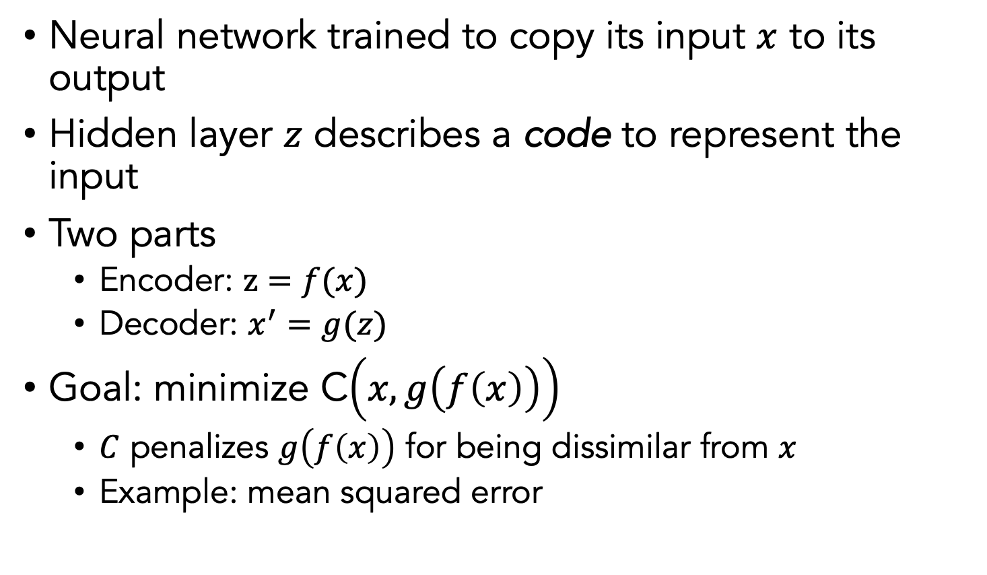
Autoencoder (AE)
Neural network trained to copy its input $x$ to its output
Hidden layer $z$ describes a code to represent the input
Two parts
Encoder: $z=f(x)$
Decoder: $x^{′}=g(z)$
Goal: minimize C$\left(x,g\left(f\left(x\right)\right)\right)$
$C$ penalizes $g\left(f\left(x\right)\right)$ for being dissimilar from $x$
Example: mean squared error
Notes:
Autoencoders are special types of neural networks that have been used to do unsupervised and semi-supervised settings
Recirculation compares activations of the network on the original input to the activations on the reconstructed input (considered more biologically plausible)

Slide 8
Autoencoders for Single-Cell Analysis
Autoencoders can do most of the single cell tasks that we have talked about so far by construction!
Dimensionality reduction
Visualization
Data denoising
Batch correction
Clustering
(synthetic) Data generation

Slide 9

How?
Code is a dimensionality reduced embedding
Reconstructed
output is denoised
(reconstructed from
Reduced dimensions)
Remaining tasks need special regularizations

Slide 10
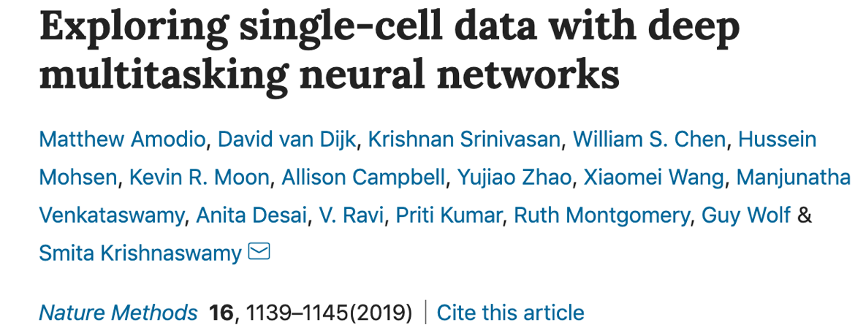
SAUCIE

Slide 11
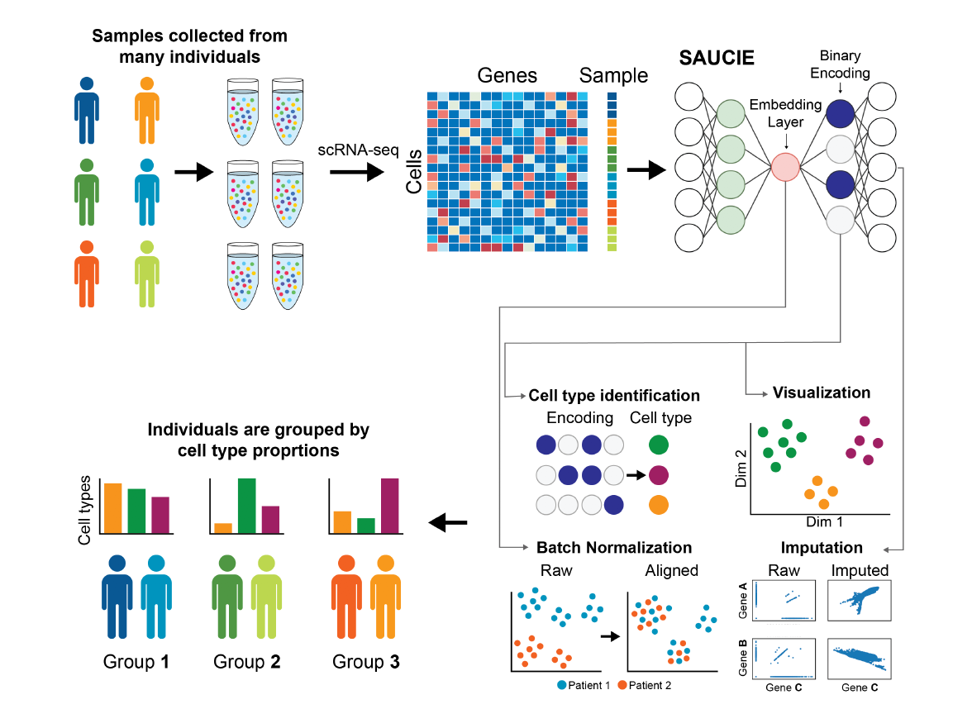

Slide 12
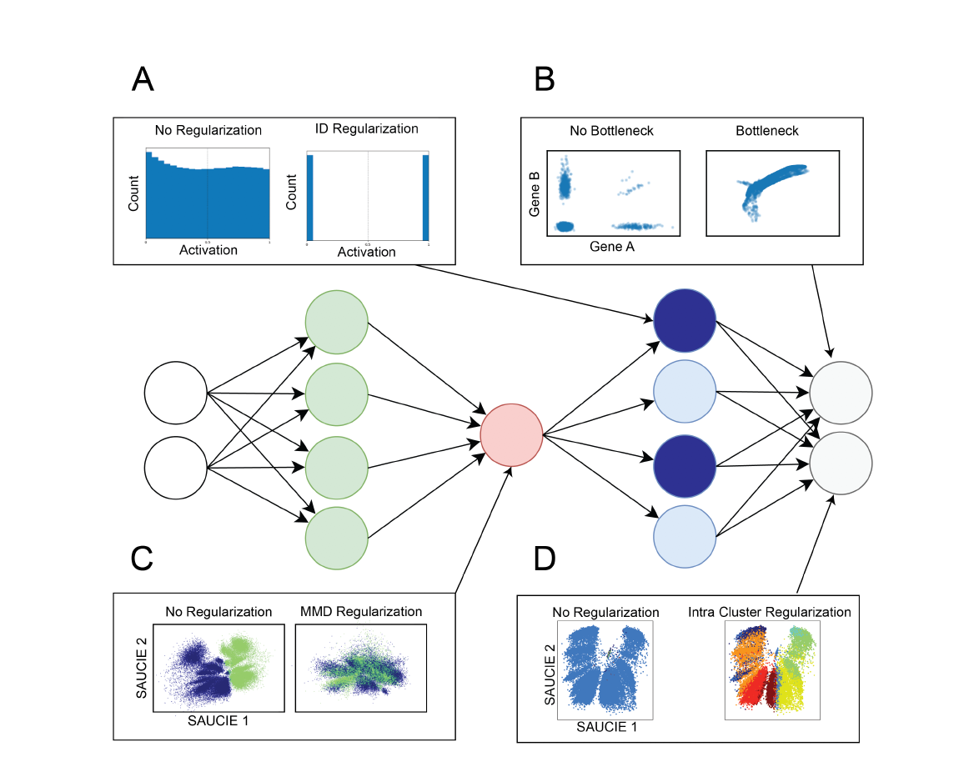
Clustering
Denoising
Batch correction / Visualization
Clustering

Slide 13
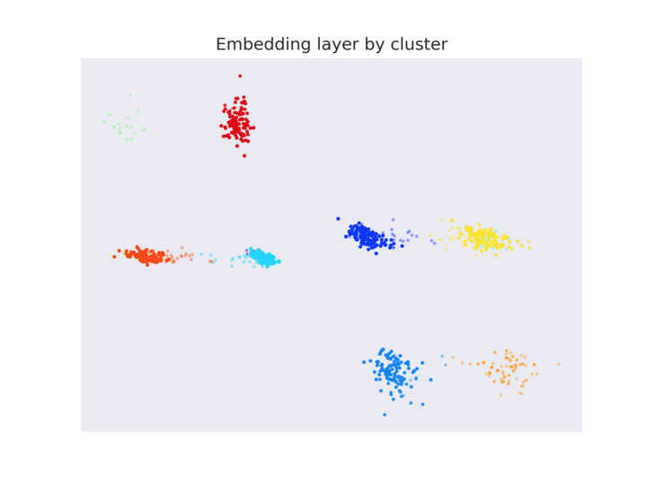
Representation for Clustering
We want: codes for subspaces
Binary activation, good spacing
Activated
Not Activated

Slide 14
Clustering: Information Dimension Regularization
High activation entropy
Low activation entropy
Penalty:

Slide 15
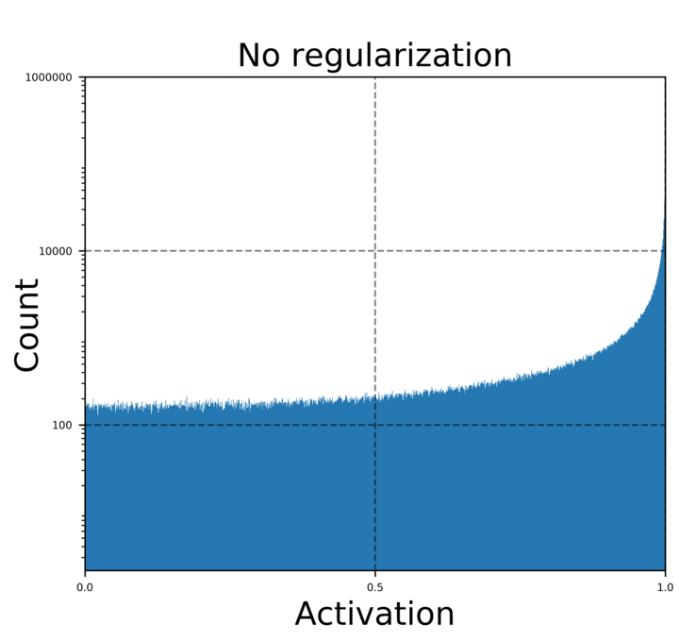
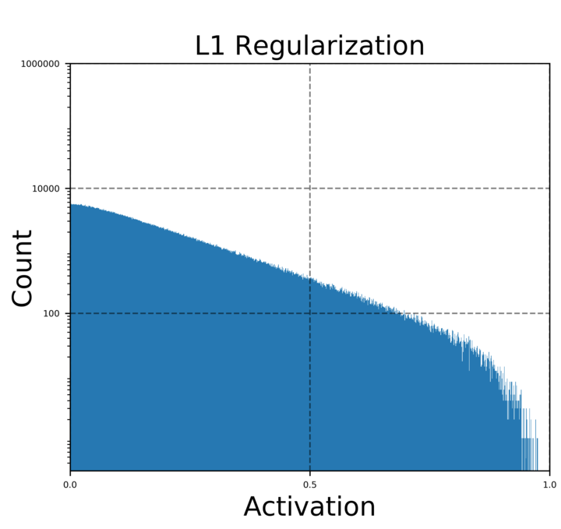
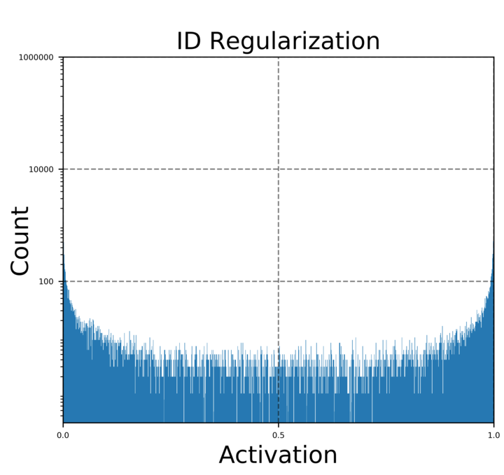
Information Dimension (ID) Regularization
No regularization
L1 regularization
ID regularization
ID regularization enforces a binary-like code

Slide 16
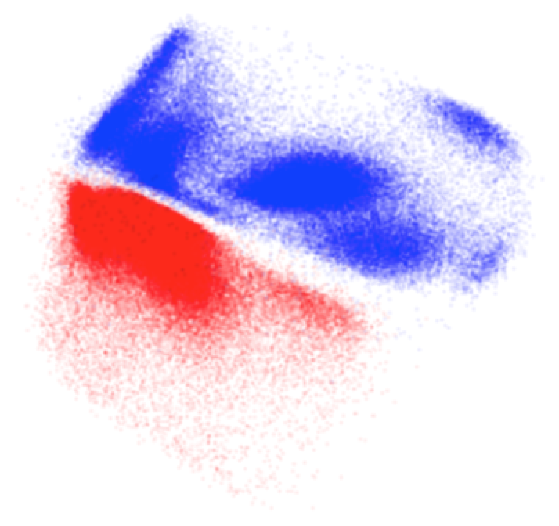
Batch Effects: Manifold Alignment
Patient 1
Patient 2

Slide 17
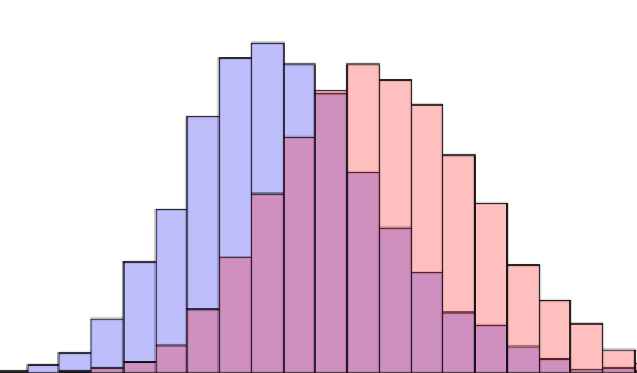
Mean Maximal Discrepancy
[Dziugaite, Roy, Ghahramani, UAI 2015]

Slide 18
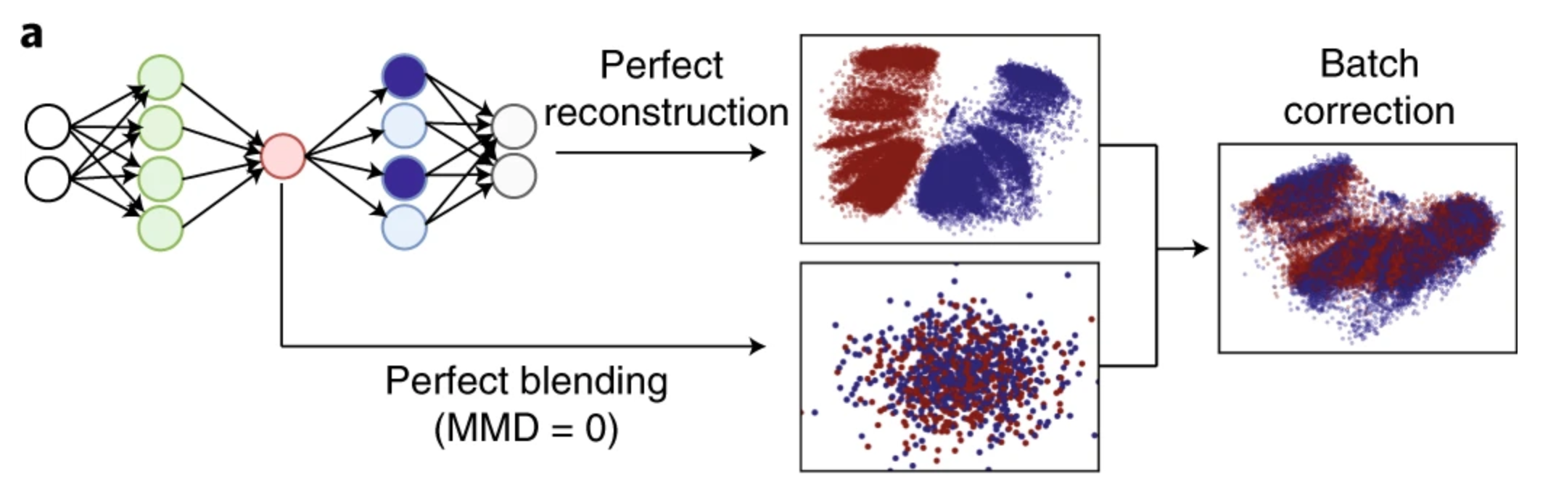
MMD Penalty on middle layer is opposed by reconstruction

Slide 19
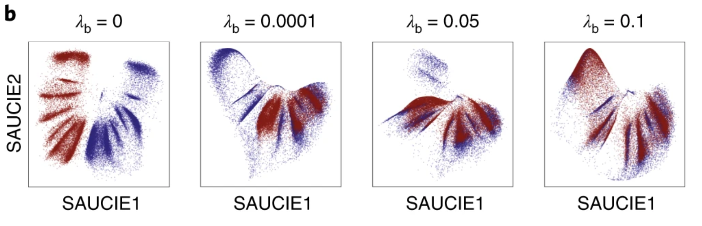
MMD Penalty on middle layer is opposed by reconstruction

Slide 20
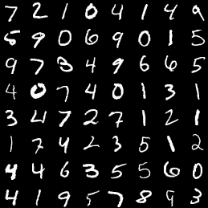
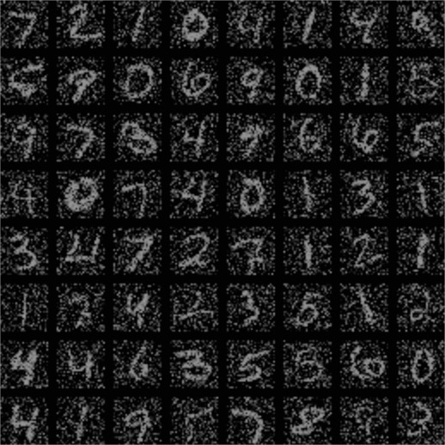
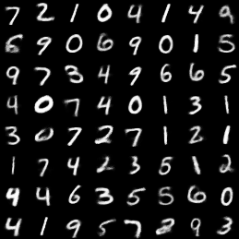
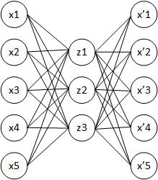
Reconstruction as Denoising
Original
Dropped-out data
Reconstructed
Notes:
The autoencoder naturally learns an imputed and denoised version of the data

Slide 21
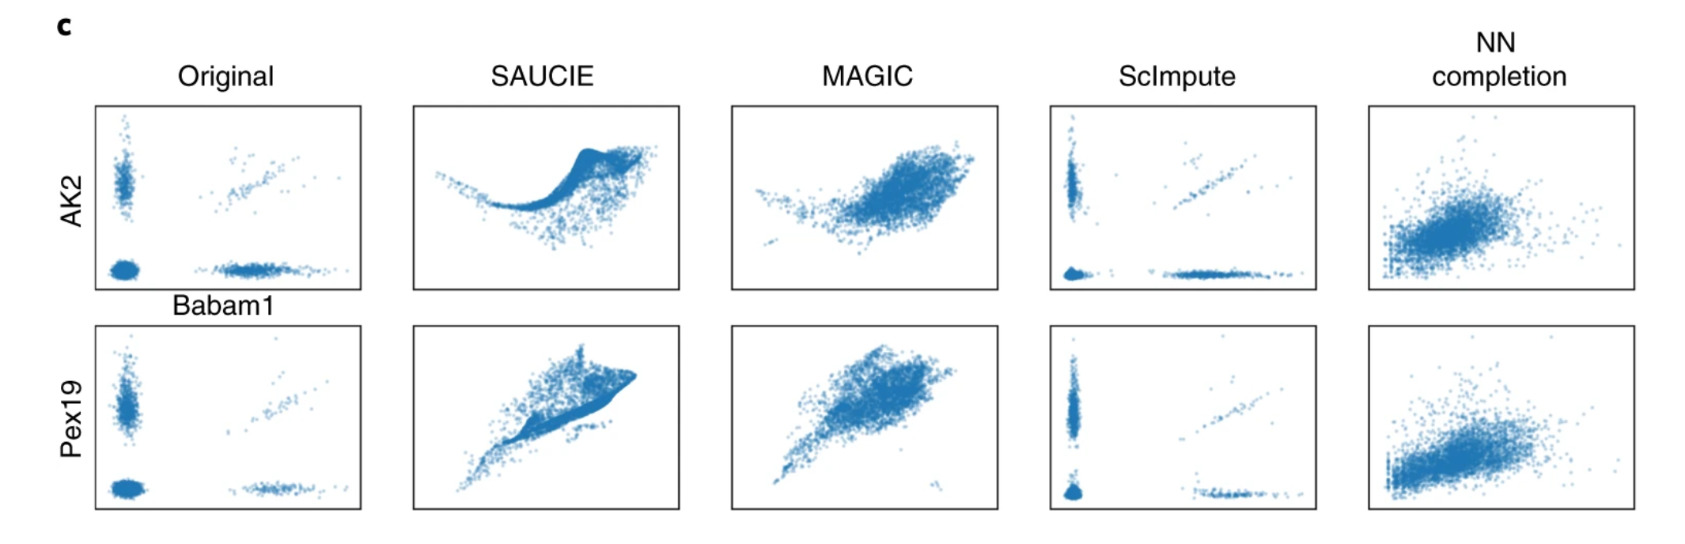
SAUCIE data denoising

Slide 22
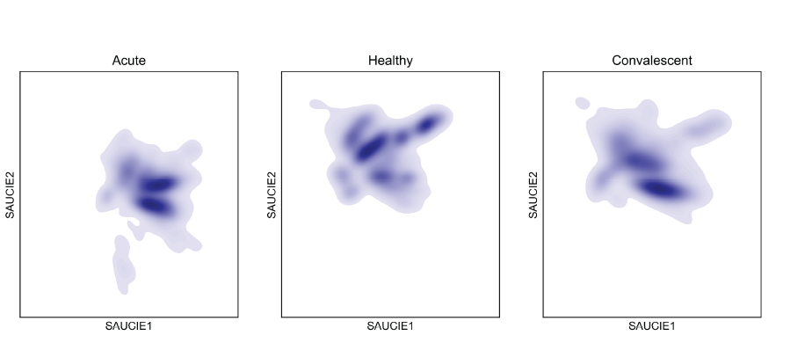
Cellular Manifolds of Dengue Patients

Slide 23
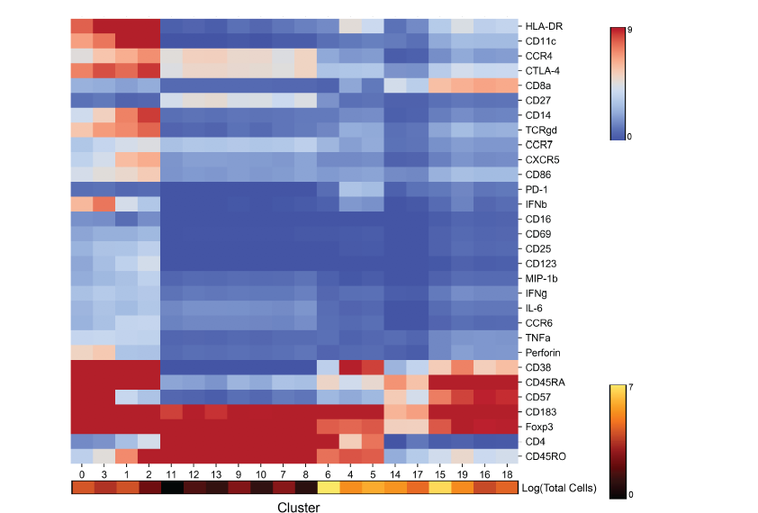
Cell Clusters: 180 Samples Combined

Slide 24
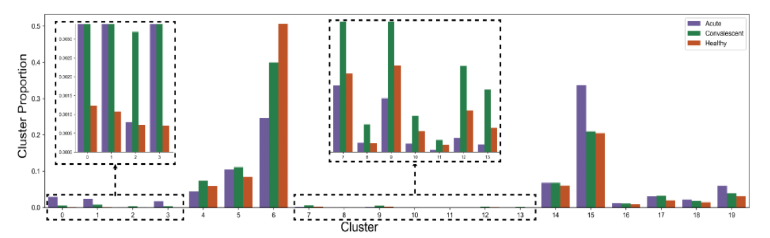
Patient Cluster Signatures
MMD distance can be derived between patient cluster proportions and embedded

Slide 25
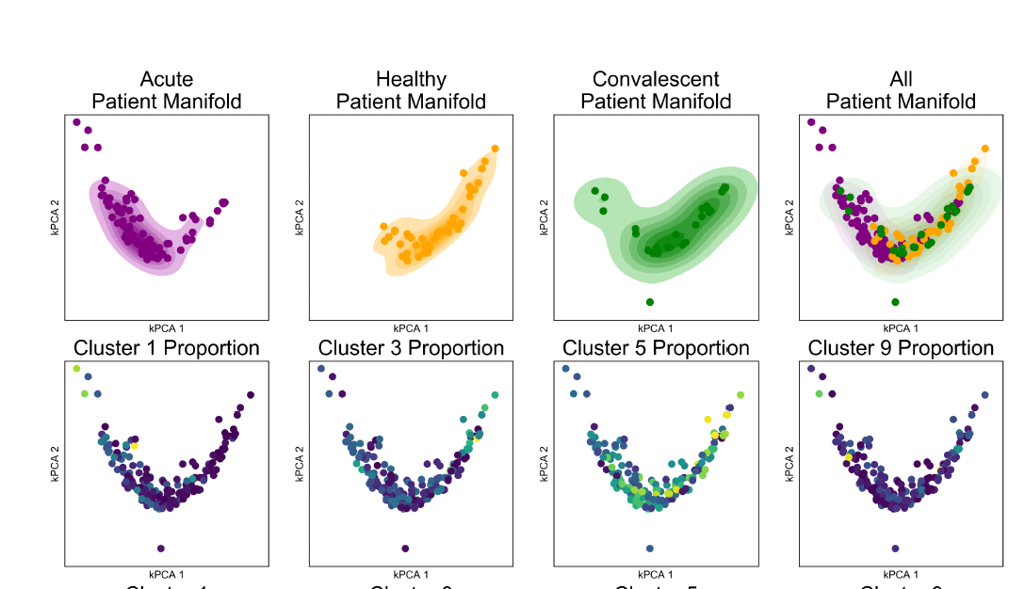
Patient manifolds show coherent organization

Slide 26
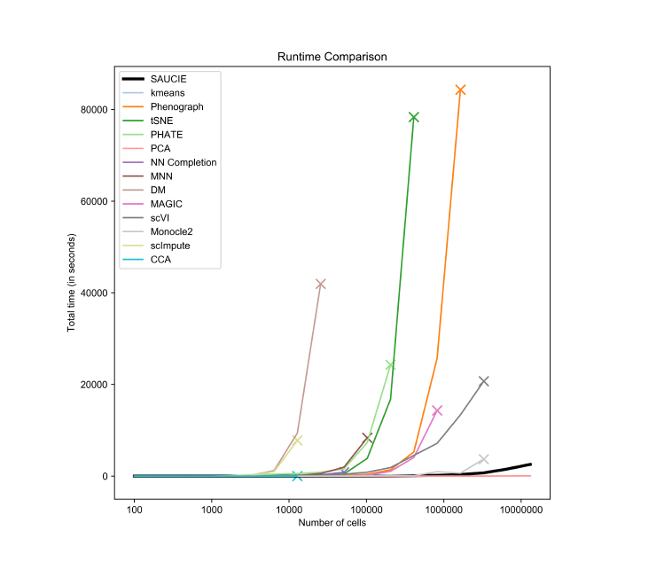

Slide 27
Generative Models

Slide 28
Generating samples from the data
Key use of neural networks is generating samples from data
One idea is to use the decoder without the encoder, sample from z and then have it decode to a datapoint
For single cell data, this would mean generating synthetic cells from a distribution

Slide 29
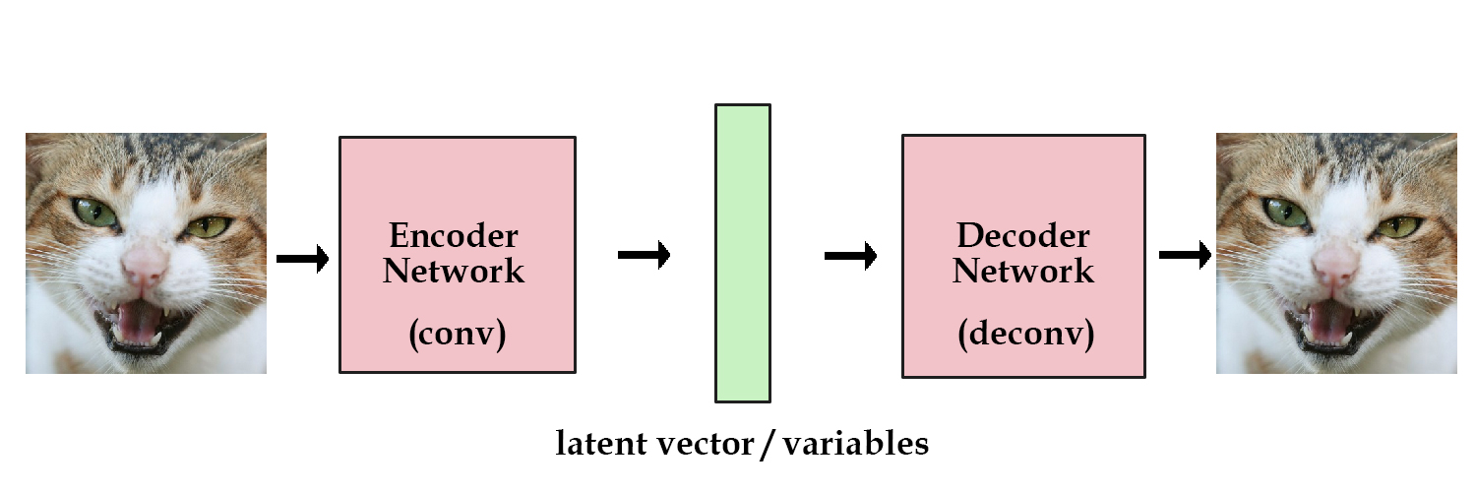
Variational Autoencoders (VAEs)
A type of neural network whose latent space is designed for sampling
Notes:
Shifting gears now to generative models
Ask them for any ideas?

Slide 30
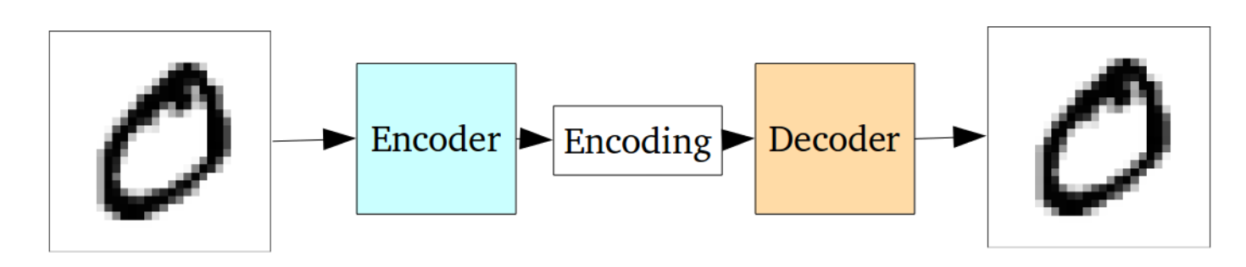
Why not autoencoders?
Optimized with Reconstruction Loss
Not explicitly penalized for Generative Purposes

Slide 31
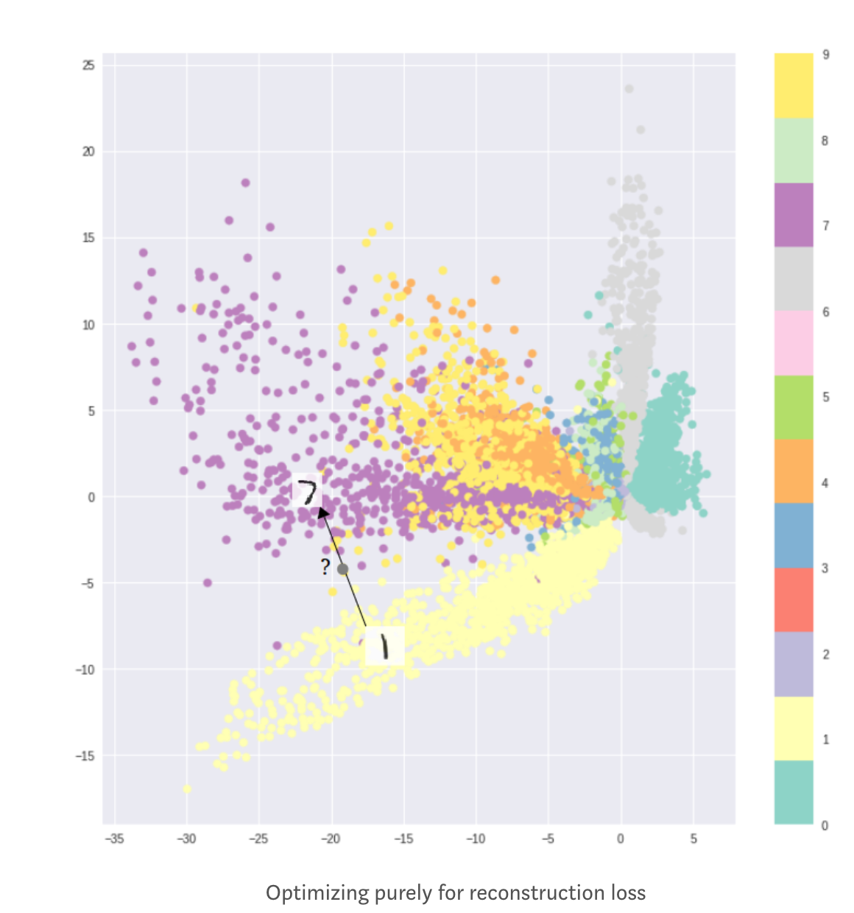
Latent Space Not Optimal for Generation
Formation of clusters helps decoding
Does not help generation
Latent space cannot be interpolated

Slide 32
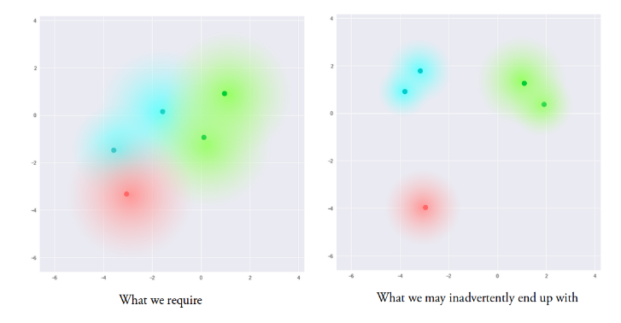
Encouraging continuous latent spaces
Solution: Penalize the Gaussian balls if they don’t overlap!

Slide 33
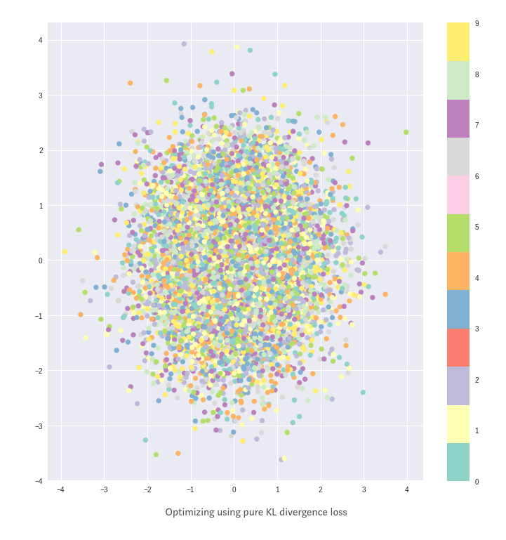
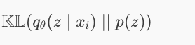
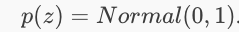
KL Divergence Penalty
Penalizing distributions
In the latent space from being
too far from a standard normal
Encourages every ball to be the same!

Slide 34



Loss Function of VAE
Reconstruction penalty encourages separation

Slide 35

KL+Reconstruction Loss

Slide 36

Variational Autoencoders (VAEs)
1st Epoch
9th Epoch
Original

Slide 37
VAEs in Single Cell Analysis.

Slide 38

scVI

Slide 39

sCVI
scVI uses latent space of VAE as a dimensionality reduced encoding fed to other algorithms

Slide 40

Probabilistic assumptions

Slide 41
Latent Space Arithmetic

Slide 42

scGEN

Slide 43
scGEN
Generates single cell response by doing latent space arithmetic
Perturbations are modelled as shifts

Slide 44


Generative Adversarial Networks
Noise
Something “like” training sample
Notes:
Visualization of samples from the model. The rightmost column shows the nearest training example of the column just to the left.

Slide 45

GAN functionality

Slide 46
GANs
Sample from an easy noise distribution (uniform, Gaussian)
One network learns a mapping G(Z)
Second network tries to distinguish true examples of X from “fake” samples G(Z)

Slide 47
2 Networks
Generator: takes random noise and transforms into sample from target distribution
Discriminator: discriminates between generated (“fake”) examples and real examples
The two networks play a “minimax game”
Indirect way of matching distributions

Slide 48


Only use generator after training
Generator network takes noise and transmutes them into samples from the data distribution
Implicitly learns high dimensional distributions

Slide 49

Generated Examples

Slide 50

GAN Loss function
Maximize discriminator value (1) on real samples
Maximize discriminators value (0) on generated samples
Generator wants the discriminator to do badly!

Slide 51
GAN Loss function
min_{G} max_{D}
This is the minimax game that the two adversaries play

Slide 52

Mode Collapse

Slide 53
GANs can be hard to train
Instability during training
Mode collapse
Take the whole batch as a training sample
Penalize for a property of the distribution (mean, variance)

Slide 54
Conditional GANs
GANs take noise z and turn it into our data x
Great! But what if we want to control it?
“It generated another image of a 3? I wanted a 7 this time!”
Conditional GANs:
If we have labels, we want to teach it to generate not just any x, but an x of a particular label when given some noise z

Slide 55
Conditional GANs
Condition
“8”

Slide 56
Conditional GANs
Condition
“8”

Slide 57
Conditional GANs
Condition
“8”
Both generator and discriminator look at the condition

Slide 58

cSCGAN

Slide 59
cscGAN
Maps from noise to single cell measurments
Conditions correspond to cell types in PBMCs
Some cell types are naturally rare, may want to augment measurements with
“in silico” cell generation

Slide 60

cscGAN
Generated cells visualized on tSNE

Slide 61
Domain Adaptation and Cycle GANs

Slide 62


Domain Adaptation
GANs and adversarial AEs sample from one domain
What if we have two domains, A and B?
A=single cell RNAseq, B= single cell ATACseq
A=healthy, B=diseased
A=control, B=perturbed
A=batch1, B=batch 2?
Normal
Cancer
Notes:
For the paired example, need a black and white image and a colored image to learn how to color a black and white image

Slide 63


Unsupervised matching
Can we learn to turn a point in A into a point that looks like its from B?
We don’t have the “answer” or corresponding measurement in the other modality
CyceGAN frameworks were set up to do this

Slide 64

DiscoGAN: Motivation
Domain A: blond hair
Domain B: black hair
Previous approach
Kim, Taeksoo, et al. "Learning to discover cross-domain relations with generative adversarial networks." arXiv preprint arXiv:1703.05192 (2017).
Notes:
Note that the architecture of each of these are only mappings (not autoencoders although they kind of look like it).
This idea was nice, but the results weren’t very good. You would get someone with black hair, but it didn’t look like the person in the original image.

Slide 65
DiscoGAN
Domain A: blond hair
Domain B: black hair
Kim, Taeksoo, et al. "Learning to discover cross-domain relations with generative adversarial networks." arXiv preprint arXiv:1703.05192 (2017).

Slide 66
DiscoGAN
Weight sharing/reuse is important
Same reason CNNs work
Same network weights/activations must perform multiple tasks
Indirectly increases number of training samples and generalizability
Reduces number of weights to train
Optimization is easier
Kim, Taeksoo, et al. "Learning to discover cross-domain relations with generative adversarial networks." arXiv preprint arXiv:1703.05192 (2017).

Slide 67


DiscoGAN

Slide 68


DiscoGAN
Issues
Is this the correct shoe for this purse?
Is there a better match?
Original paper doesn’t talk about it
Sometimes the mapping isn’t correct
Notes:
Later paper showed that DiscoGAN sometimes was essentially counting pixels to match (e.g., the blue shoe)

Slide 69

MAGAN

Slide 70

MAGAN Architecture
Notes:
DiscoGAN hopes that if you’re regenerating a 3, then the middle layer should look like a 3 too. But nothing directly enforces that. By adding a correspondence loss, this forces them to be the same.
Example: CyTOF with shared channels. Force the shared channels to match each other.

Slide 71
MAGAN
Ensures that cells translated from domain A to domain B still correspond in some way
This is enforced by a correspondence loss
Correspondence loss formulation requires domain specific knowledge
How can we tell if a normal cell and a stimulated cell could correspond?
If the cell type is the same (stimulated T cells are still T cells)

Slide 72

Notes:
How can we tell that a cell measured with scATAC-seq is similar to a cell measured with scRNA-seq
https://www.polleverywhere.com/free_text_polls/1OUyW48tk8awcv5cMIelW

Slide 73

Combining 2 cytof Panels
2 Panels A and B
Each panel has 40 markers, 10 are shared
Want a dataset with 30+10+30=70 markers!
For each cell measured with panel A, generate panel B
Correspondence loss: difference between shared markers should be small
Superimposing Manifolds
Aligning Manifolds

Slide 74

Aligning CyTOF Batches
MAGAN correctly matches the cell types in the two batches

Slide 75


Aligning CyTOF Panels w/ MAGAN
Validation on publicly available CyTOF data from developing mouse brain*
GAN w/o Correspondence
MAGAN
* Setty, Manu et al. “Wishbone identifies bifurcating developmental trajectories from single-cell data“. Nature Biotechnology.

Slide 76

Matching rotated digits
100 simulations of each model
GAN w/o Correspondence
MAGAN
Notes:
Correspondence in this case was a semi-supervised approach where a single pair of samples was given

Slide 77
Notes:
What could be some other uses of GANs and conditional GANs or cycleGANS?
https://www.polleverywhere.com/free_text_polls/7aC105N1IL9nWpTVAEYvz

Slide 78
https://bit.ly/YaleML_May_PostSurvey

